Slide 1
Vrinda Store Analysis Annual Sales Report 2022
Insights and Recommendations for 2023 Growth

Slide 2
Welcome to the annual sales report presentation for Vrinda Store, focusing on the year 2022. This analysis aims to provide valuable insights into our sales performance, customer demographics, and order patterns over the past year. By leveraging Excel and Power Query for data cleaning and transformation, we have created an interactive dashboard to visualize key metrics and trends. Our primary objective is to understand our customers better and identify opportunities to enhance sales in 2023.
Introduction

Slide 3
Problem Statement
Compare the sales and orders using a single chart.
Identify the month with the highest sales and orders.
Determine whether men or women purchased more in 2022.
Identify different order statuses in 2022.
List the top 5 states contributing to the sales.
Explore the relation between age and gender based on the number of orders.
Identify the channel contributing to maximum sales.
Determine the highest selling category.

Slide 4
Tools and Techniques
Data Source: Vrinda Store 2022 Dataset
ETL Process
Extract: Data extraction from Vrinda store sales records
Transform: Data Cleaning, Transformation, and Normalization using Power Query
Load: Loading transformed data into Excel for analysis
Data Visualization: Excel Dashboard
Analysis Techniques:
Trend Analysis
Time Series Analysis

Slide 5
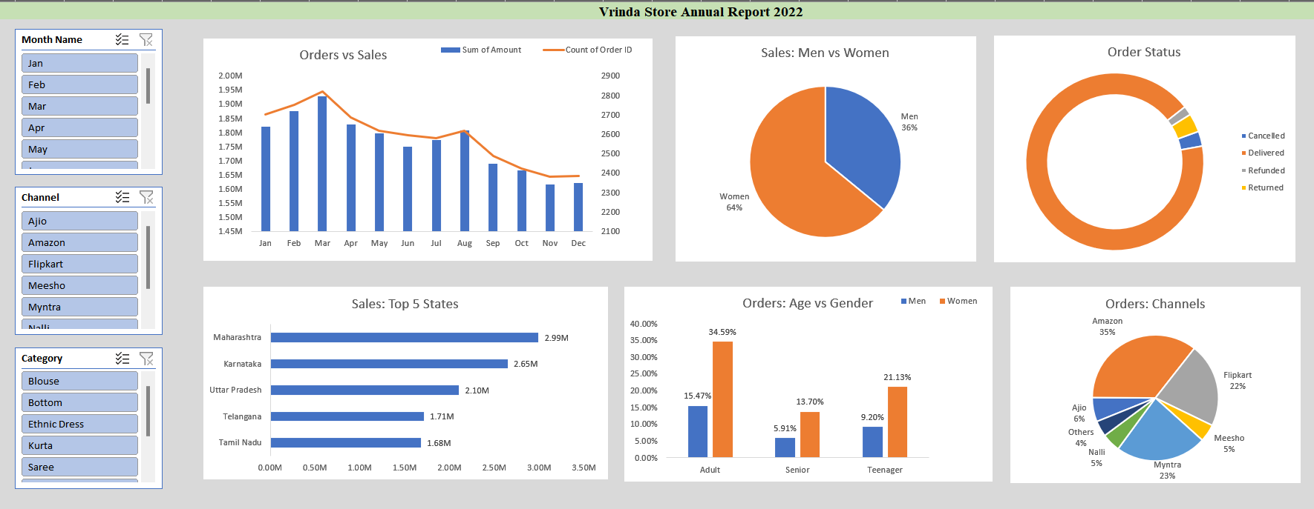
Excel Dashboard

Slide 6
Insights
March month had the highest sales and orders
Women are more likely to buy compared to men (~65%)
Delivered orders: 28,641, Returned orders: 1,045
Maharashtra, Karnataka, and Uttar Pradesh are the top states (~35%)
Adults (30-49 years) are the largest contributing age group (~50%)
Amazon, Flipkart, and Myntra channels contribute ~80% of sales

Slide 7
Recommendation
Target Audience: Women aged 30-49
Key Locations: Maharashtra, Karnataka, and Uttar Pradesh
Promotion Channels: Focus on Amazon, Flipkart, and Myntra
Strategies: Implement ads, offers, and coupons targeting the specified demographics on the key channels

